Slide 1
Donnerstag, den 21. April
Unsere Lieblingsgruppen
Learning objective:
To give and understand presentations about music that we like.

Slide 2
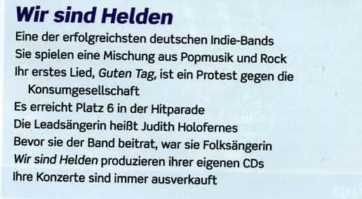
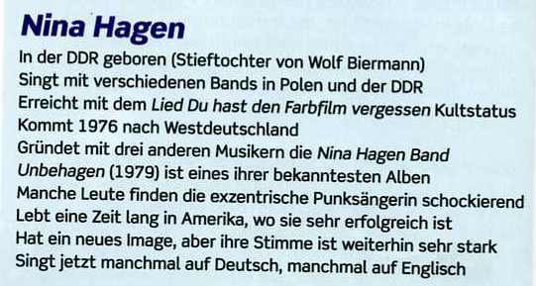
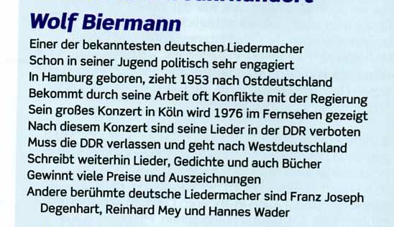

Slide 3
Presentations
Give your presentation
Ask your 3 questions
Rest of the class
Listen to presentations
Answer questions
Give ‘2 stars and a wish’

Slide 4
Linguascope

